Slide 1
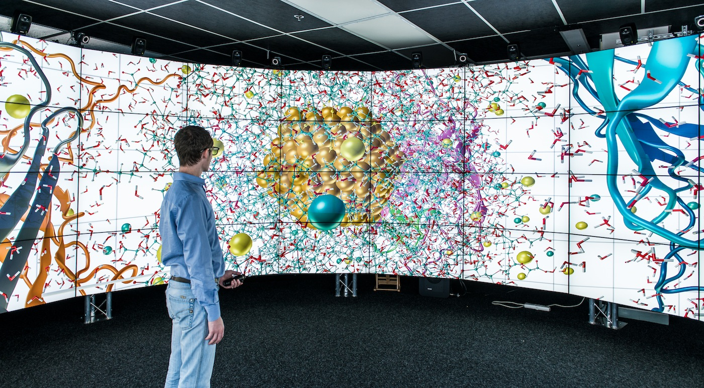
CAVE2
Leandro Baroca and Dylan Fernandes

Slide 2
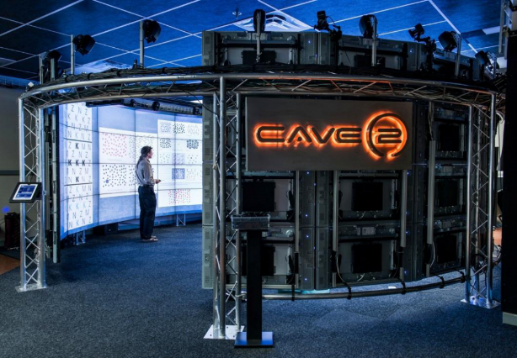
What is CAVE2
Cave2 is a next generation Hybrid Visualization Environment. CAVE 2 combines the benefits of scalable-resolution display walls with a ground-breaking, second-generation virtual reality system.
Below are the specifications of CAVE 2:
320 degree, panoramic design
20.1 surround sound audio system
Scalable high-performance computer cluster
Ultra high quality resolution of 0.29 inch per pixel
60’ x 8’ display, for 480 square feet of viewing surface

Slide 3
What CAVE2 can be used for
In today’s information rich world there are limitless uses for virtual environment, such as:
Info-rich data analysis
Virtual environment simulation
Oil and gas discovery
Design engineering
Training
Architectural design
Large-scale collaboration

Slide 4
How CAVE2 can be used on Business Systems
Cave2 can be used in many businesses that is based on science research, construction and medical research. For example:
CAVE2 can help improve architecture because they can look at their plans in depth.
It can help with science research because you can view microscopic environments on a large scale
It could help with medical research by viewing the body on a large scale to check how diseases affect the body.
IT could be used for Estate Agents for touring inside a house instead of visiting the physical property.
These were a few examples of are many, limitless uses that CAVE2 helps with Business Systems.

